Slide 1
Two-Level Translation Lookaside Buffers
Current Implementation
L1 miss, look up in L2
If found, insert the entry into L1
L2 miss
OS goes to
page table
L1 Private
flush all upon process switching
64 entries
L2 Shared for multiple processes
selective flushing
For 1 process
256 entries
For 1 process
256 entries
For 1 process
256 entries
For 1 process
256 entries

Slide 2
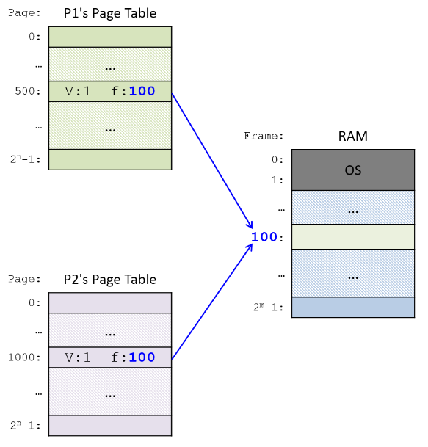
Future design: Considering shared TLB entries
Shared TLB entries can be designed for shared physical pages among different processes (e.g. shared libraries), so that the same address mapping does not appear multiple times in TLB.
When designing the corresponding flushing policies, try to avoid flushing these shared entries.
Two-Level Translation Lookaside Buffers

Slide 3
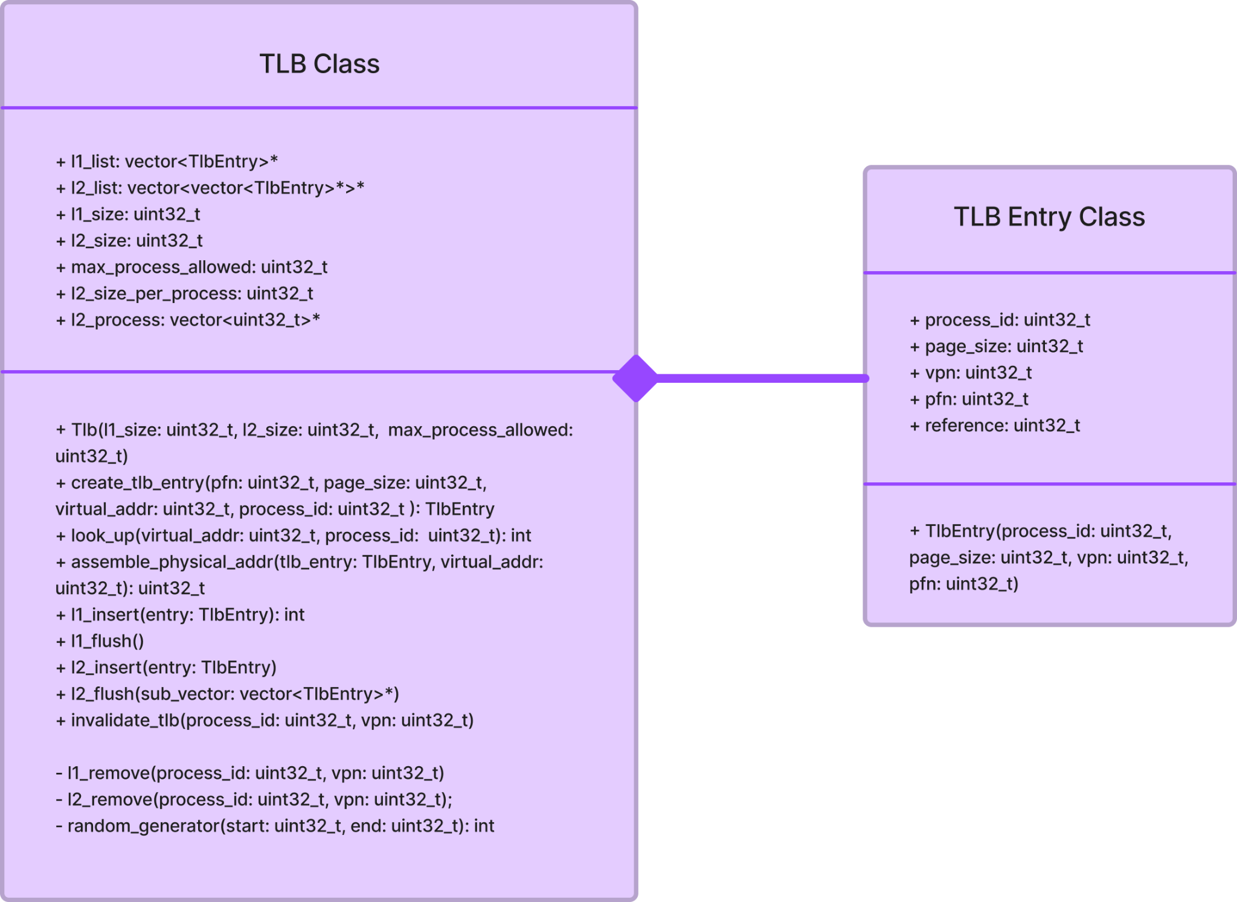
TLB
Main functionalities for TLB
Look up
Insert (FIFO and Random)
Flush
Invalidate
Assemble physical address
Users can modify
L1 and L2 sizes
Number of processes allowed in L2

Slide 4
TLB Replacement Policies
Current replacement policies:
Random
FIFO
64 entries
For 1 process
256 entries
For 1 process
256 entries
For 1 process
256 entries
For 1 process
256 entries

Slide 5
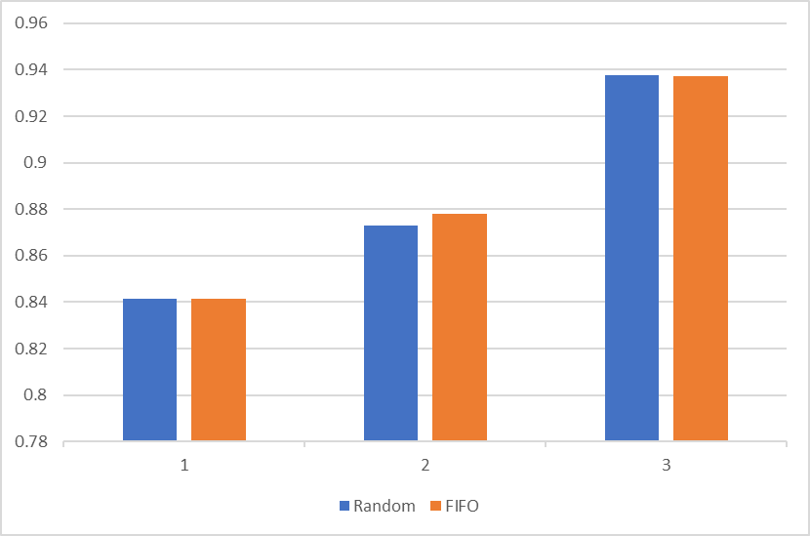
Results – random vs FIFO policy
(under 2 level TLB + variable page sizes)
TLB hit rate
Locality

